Slide 1

C Practice 6
Notes:
Click to add notes

Slide 2
C Programming Practice Question 1
1. Open Blink sketch from Arduino IDE: File | Examples | 01.Basics.
2. Move all of the code inside loop() function into a separate function called blink() and call blink() inside loop() function.
3. Verify the blink program's execution: the LED light turns on and off every one second.
Hint:
void blink()
Notes:
Lesson descriptions should be brief.

Slide 3
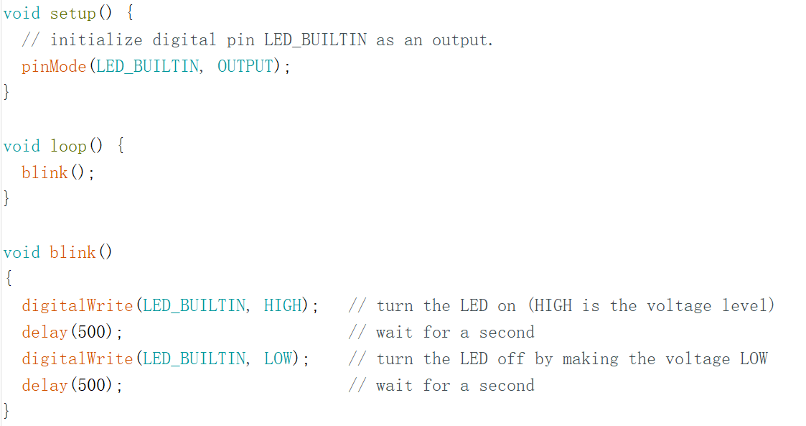
Answer
Notes:
Lesson descriptions should be brief.

Slide 4
C Programming Practice Question 2
Use String to manipulate the texts. There are two texts: text1: "This string“
text2: " has more text“
Print the lengths of text1 and text2 on the serial monitor
Append the contents of text2 to the end of text1.
Hint:
1. String.length()
2. String.concat()
Notes:
Lesson descriptions should be brief.

Slide 5
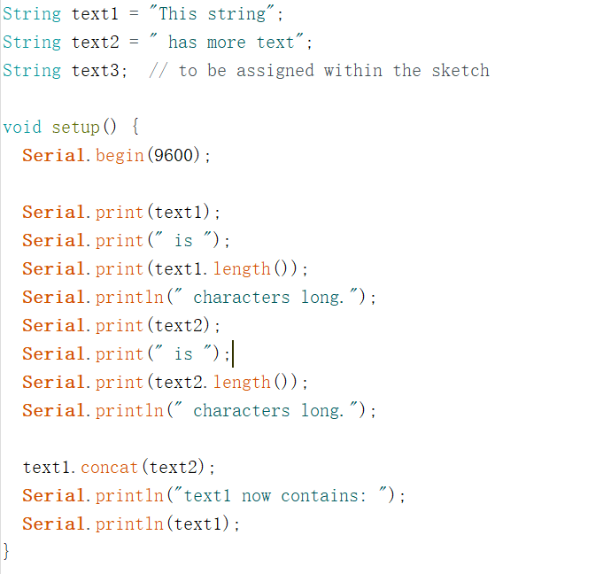
Answer
Notes:
Lesson descriptions should be brief.

